Slide 1
Multifluid model of a one-dimensional steady state force-free current sheet
SPARTHB
Zijin Zhang, Sergey Kamaletdinov, Xiaofei Shi, Anton V. Artemyev, Vassilis Angelopoulos

Slide 2
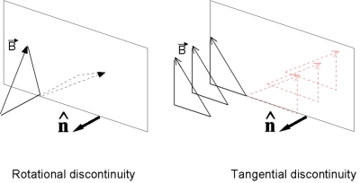
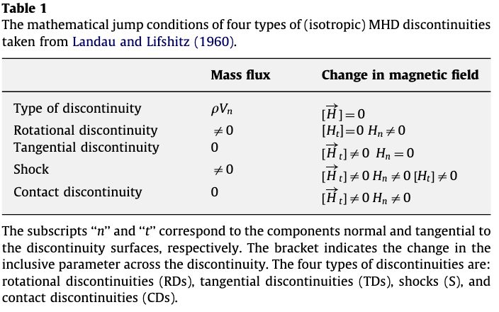
Discontinuities aka current sheets
Discontinuous changes in plasmas parameters and magnetic ﬁelds
Colburn et al., 1966
Notes:
We are interested in solar wind discontinuities because they are an import element of solar wind turbulences….
There is one result from Borovsky paper
The strong discontinuities produce a power-law spectrum in the “inertial subrange” with a spectral index near the Kolmogorov −5/3 index. The discontinuity spectrum contains about half of the power of the full solar-wind magnetic field over this “inertial subrange.”
From another point of view, SWD are a type of very kinetic structure. Which means that they can interact with the energetic part of the solar wind ions.

Slide 3
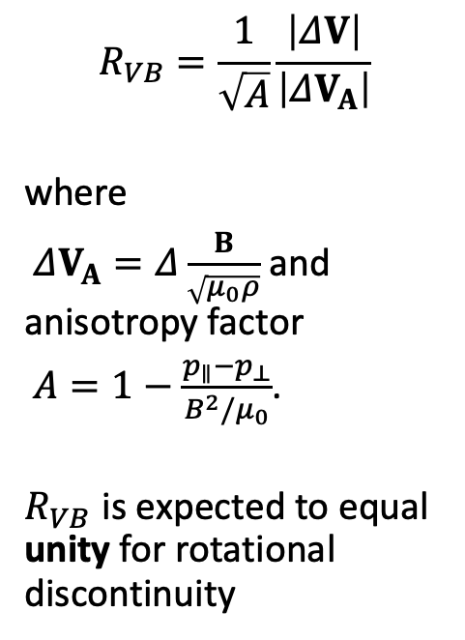
Discontinuities
$$R_{VB}=\frac{1}{\sqrt{A}}\frac{\left|ΔV\right|}{\left|ΔV_{A}\right|}$$
where
$ΔV_{A}=Δ\frac{B}{\sqrt{μ_{0}ρ}}$ and anisotropy factor
$A=1−\frac{p_{∥}−p_{⊥}}{B^{2}/μ_{0}}$.
$R_{VB}$ is expected to equal unity for rotational discontinuity
Notes:
We are interested in solar wind discontinuities because they are an import element of solar wind turbulences….
There is one result from Borovsky paper
The strong discontinuities produce a power-law spectrum in the “inertial subrange” with a spectral index near the Kolmogorov −5/3 index. The discontinuity spectrum contains about half of the power of the full solar-wind magnetic field over this “inertial subrange.”
From another point of view, SWD are a type of very kinetic structure. Which means that they can interact with the energetic part of the solar wind ions.

Slide 4
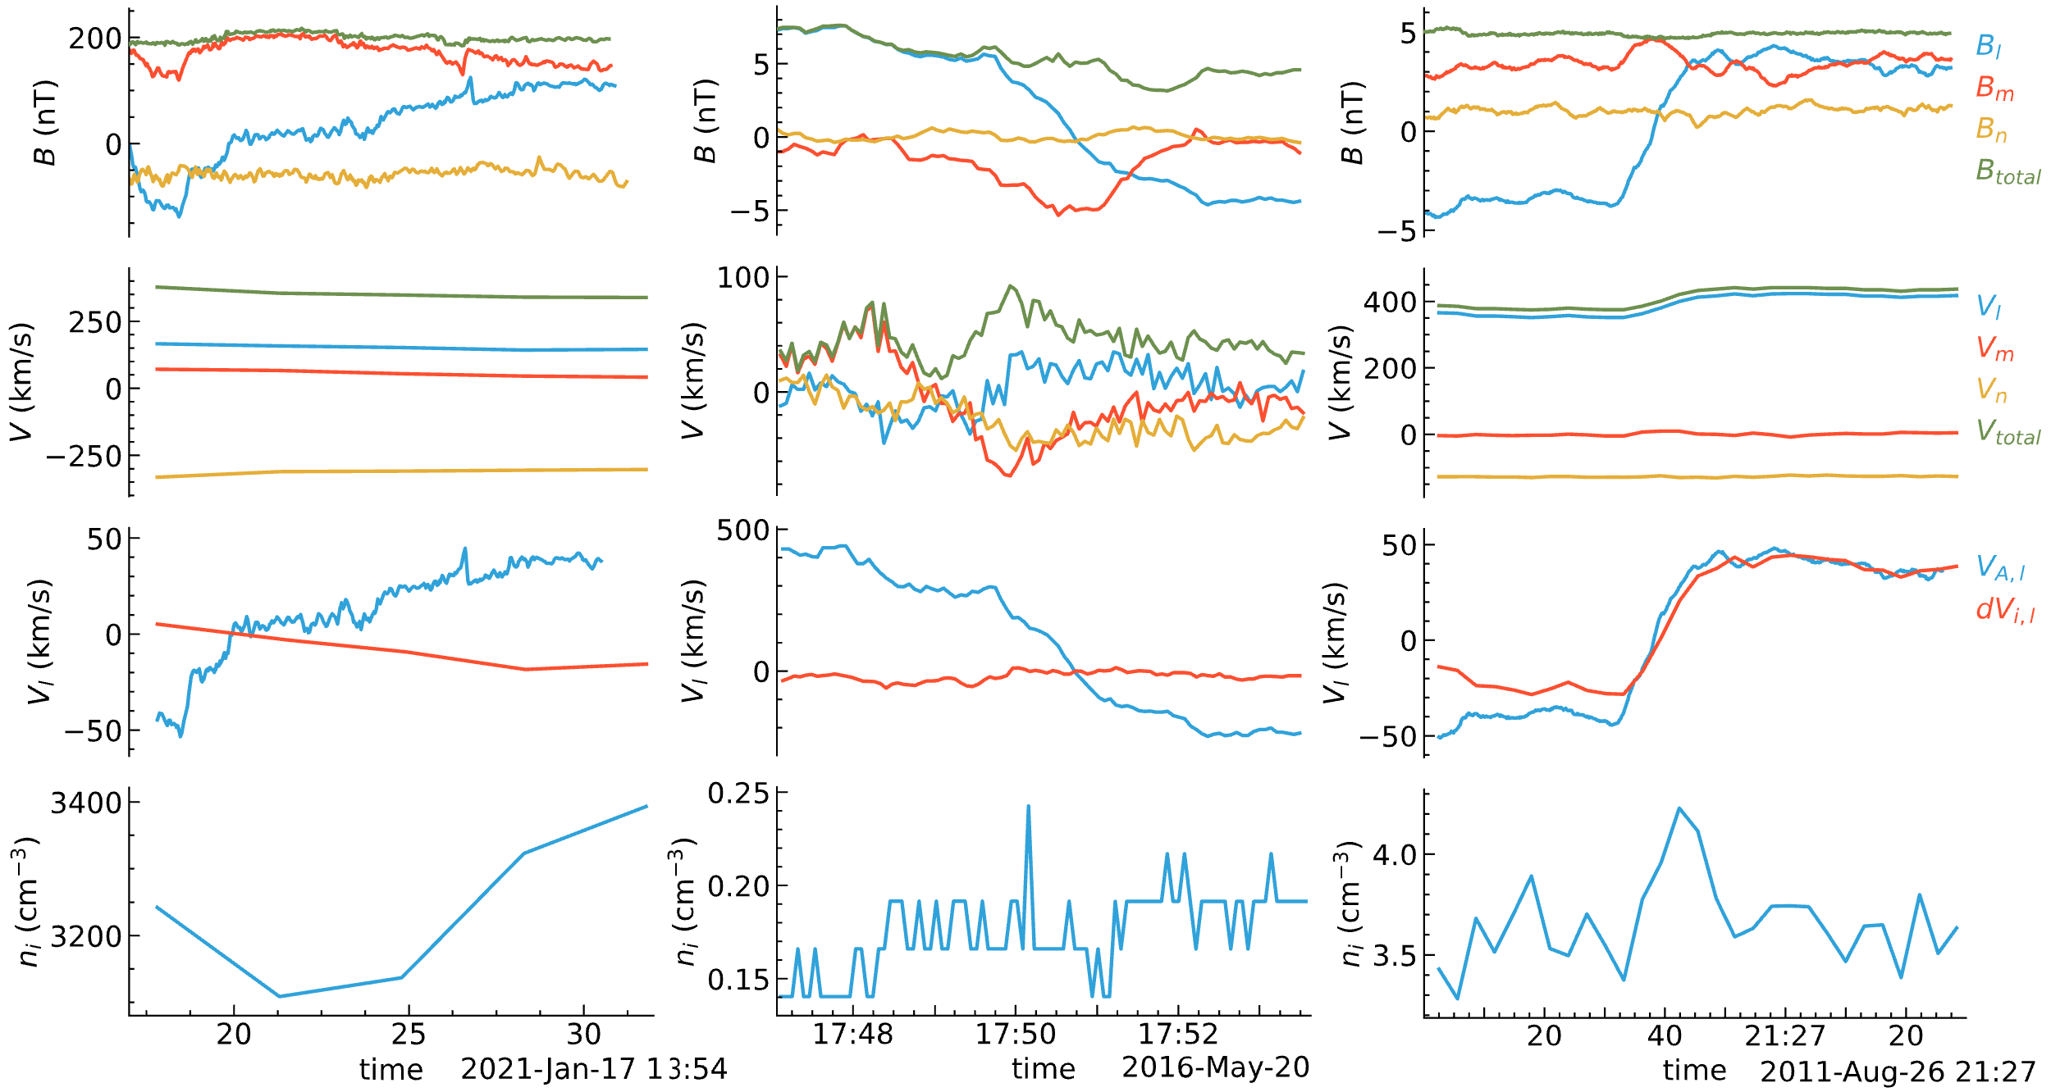
Examples
Three examples of current sheets observed by Parker Solar Probe (PSP), ARTEMIS and Wind spacecraft with sub-Alfvenic flow velocity.

Slide 5

Examples
Force-free current sheets are important for modelling low-$β$ plasmas in laboratory, space and astrophysical applications (Marsh 1996)

Slide 6
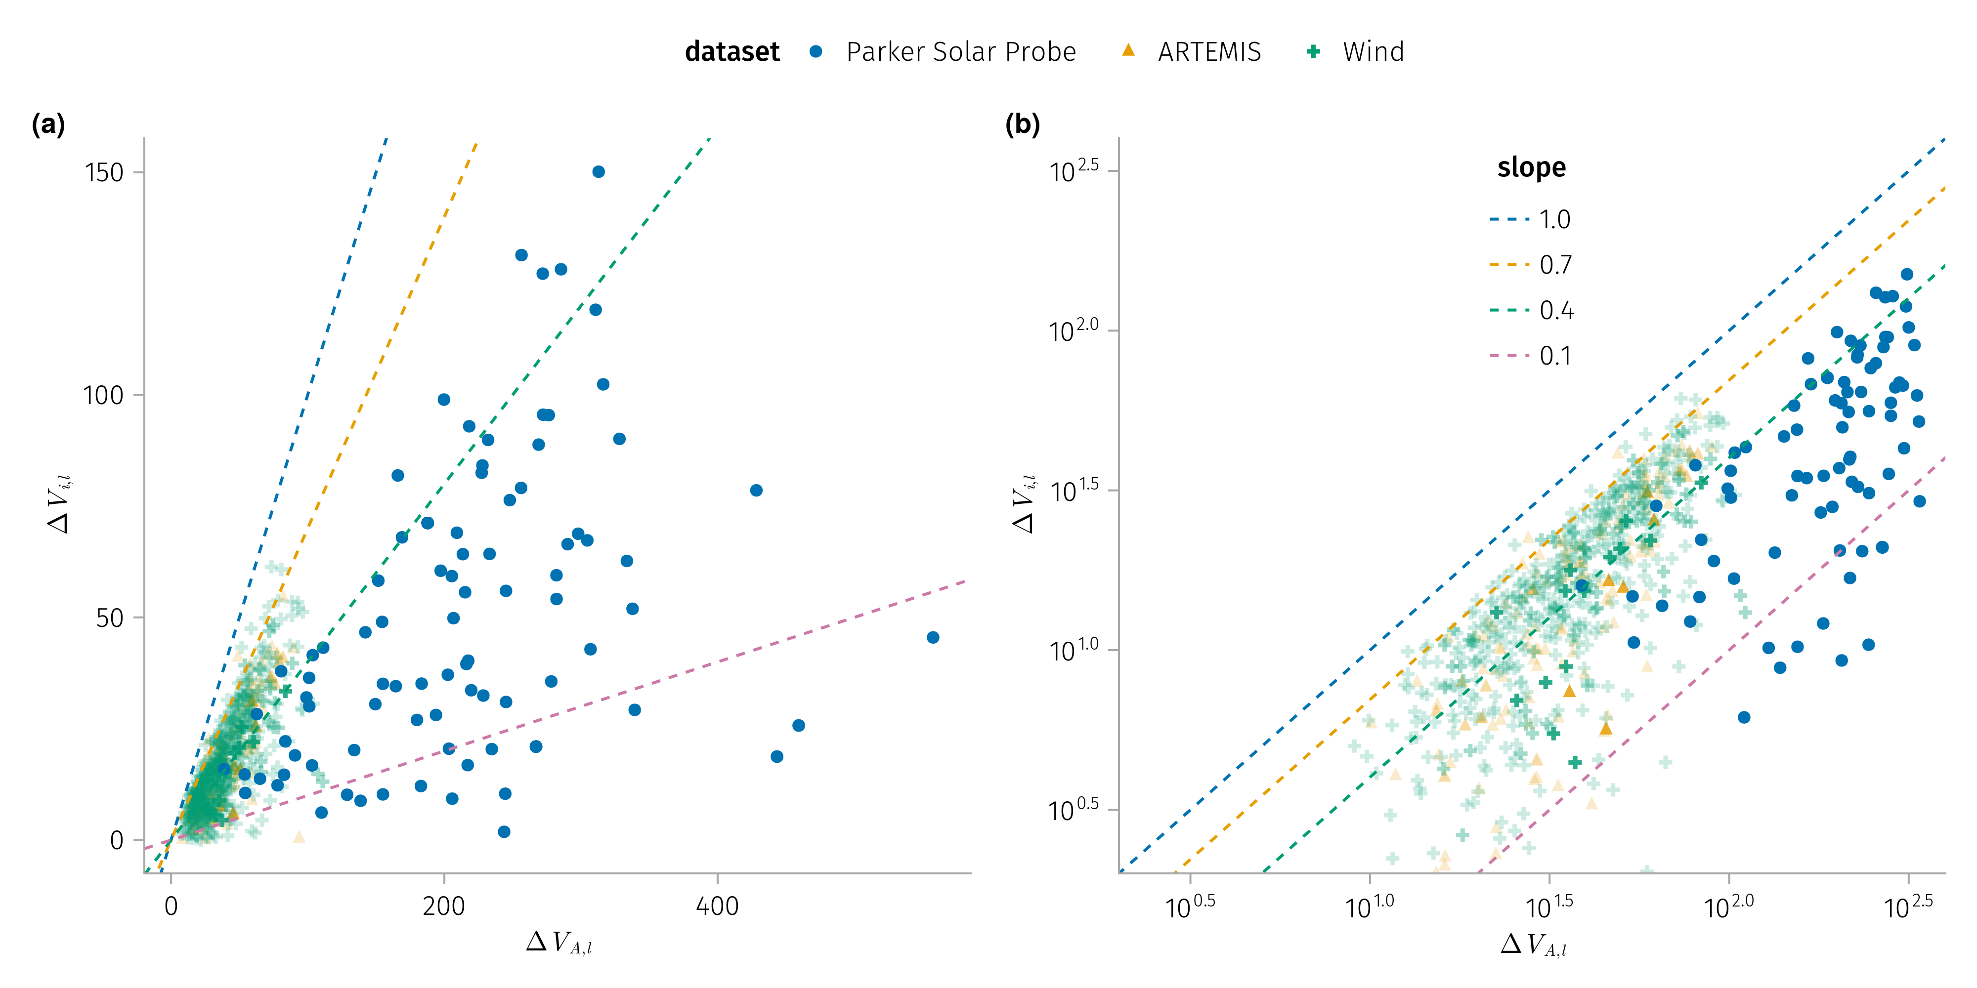
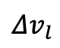
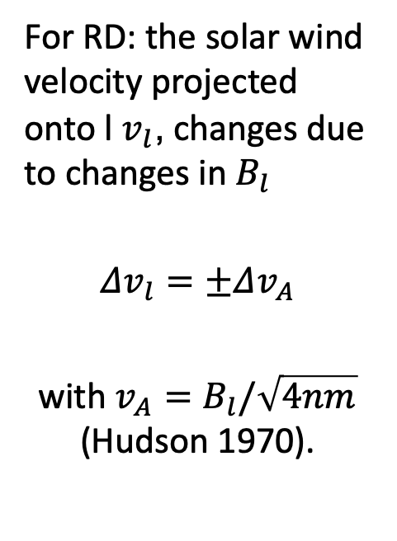
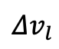
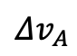
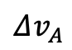

Comparison with Alfven speed and plasma speed change
For RD: the solar wind velocity projected onto l $v_{l}$, changes due to changes in $B_{l}$
$Δv_{l}=±Δv_{A}$
with $v_{A}=B_{l}/\sqrt{4nm}$ (Hudson 1970).
$$Δv_{l}$$
$$Δv_{l}$$
$$Δv_{A}$$
$$Δv_{A}$$
K1: $Δv_{l}$,l demonstrates a strong correlation with $Δv_{A}$, albeit being consistently smaller.

Slide 7
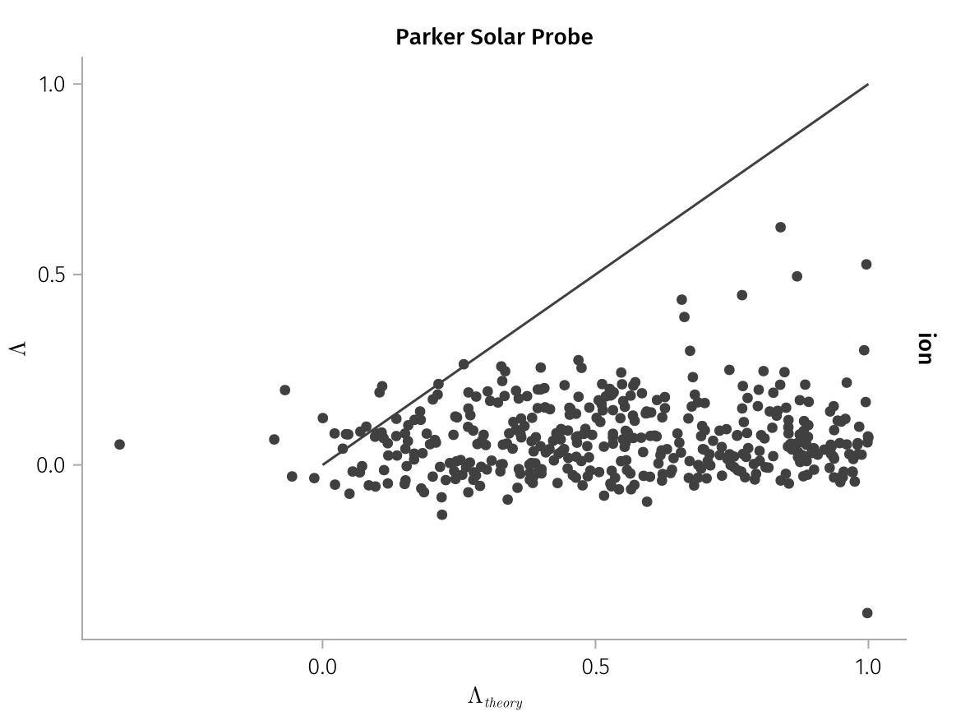
Comparison with MHD theory-predicted and directly measured anisotropies
K2: Anisotropic MHD theory-predicted anisotropies is larger than directly measured ion anisotropies

Slide 8
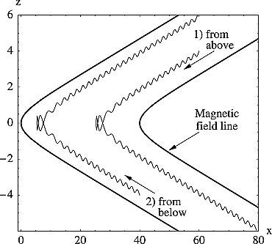
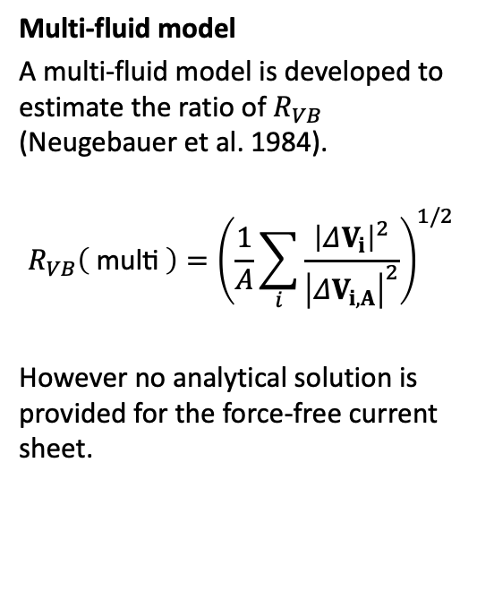
Theory - previous art
Multi-fluid model
A multi-fluid model is developed to estimate the ratio of $R_{VB}$ (Neugebauer et al. 1984).
$$R_{VB}\left( \text{multi} \right)={\left(\frac{1}{A}\sum_{i}^{​}{\frac{{\left|ΔV_{i}\right|}^{2}}{{\left|ΔV_{i,A}\right|}^{2}}}\right)}^{1/2}$$
However no analytical solution is provided for the force-free current sheet.
Ion trajectories in model magnetic field.

Slide 9
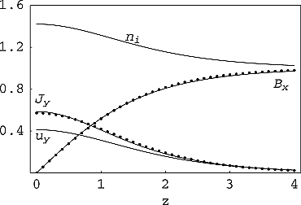
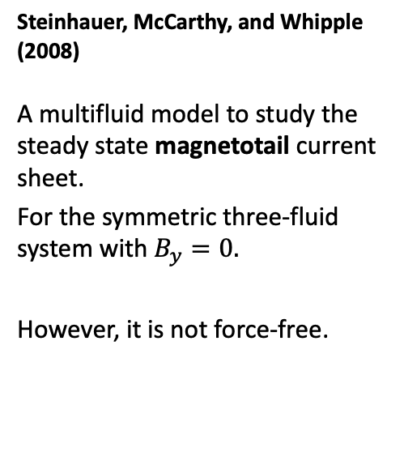
Steinhauer, McCarthy, and Whipple (2008)
A multifluid model to study the steady state magnetotail current sheet.
For the symmetric three-fluid system with $B_{y}=0.$
However, it is not force-free.
Magnetic field, current density, ion density and out-of-plane flow for Bz = 0.1, βe = 0.5, βi = 1. Solid lines are fluid model results and dot symbols are from the Harris sheet solution.

Slide 10
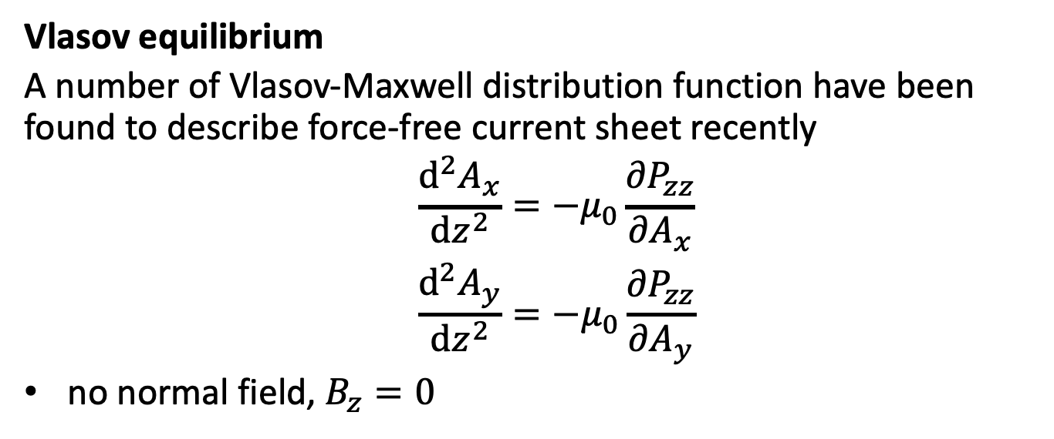
Vlasov equilibrium
A number of Vlasov-Maxwell distribution function have been found to describe force-free current sheet recently
$$\begin{matrix} & \frac{d^{2}A_{x}}{dz^{2}}=−μ_{0}\frac{∂P_{zz}}{∂A_{x}} \\ & \frac{d^{2}A_{y}}{dz^{2}}=−μ_{0}\frac{∂P_{zz}}{∂A_{y}}\end{matrix}$$
no normal field, $B_{z}=0$
Notes:
As has been shown before, the 1D VM equilibrium equations are equivalent to the motion of a pseudoparticle in a conservative pseudopotential, with the pseudopotential being proportional to one of the diagonal components of the plasma pressure tensor.

Slide 11
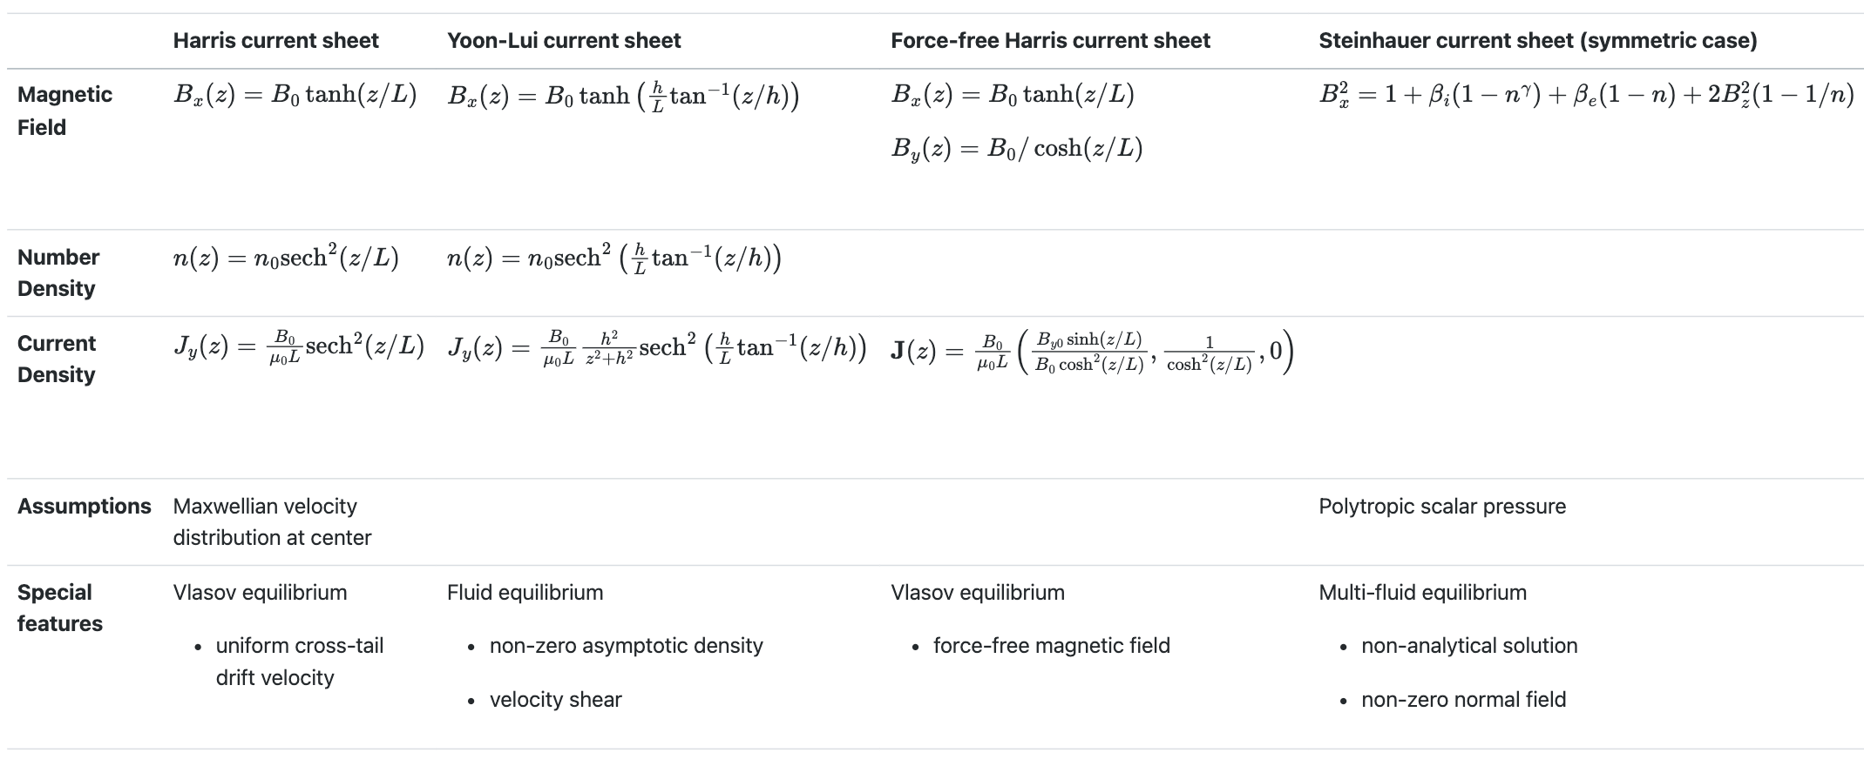
Theory - previous art

Slide 12
Plasma-Field Equations

Slide 13
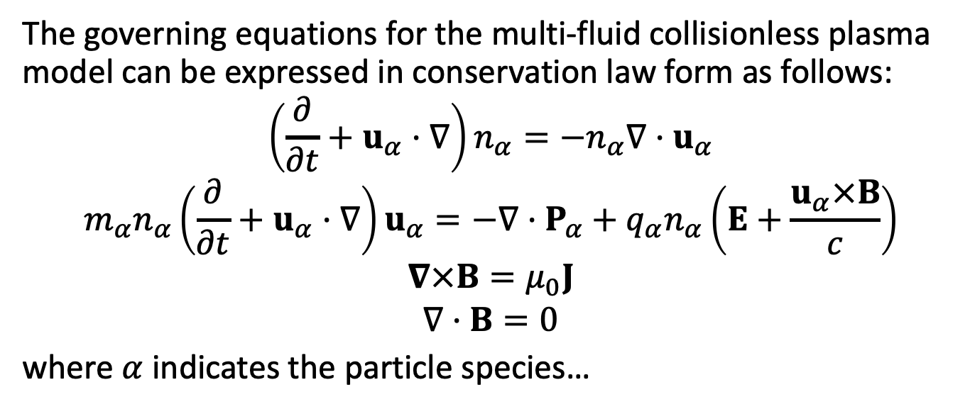
Multi-fluid collisionless plasma model in a nutshell
The governing equations for the multi-fluid collisionless plasma model can be expressed in conservation law form as follows:
$$\left(\frac{∂}{∂t}+u_{α}·∇\right)n_{α}=−n_{α}∇·u_{α}$$
$$m_{α}n_{α}\left(\frac{∂}{∂t}+u_{α}·∇\right)u_{α}=−∇·P_{α}+q_{α}n_{α}\left(E+\frac{u_{α}×B}{c}\right)$$
$$∇×B=μ_{0}J$$
$$∇·B=0$$
where $α$ indicates the particle species…

Slide 14
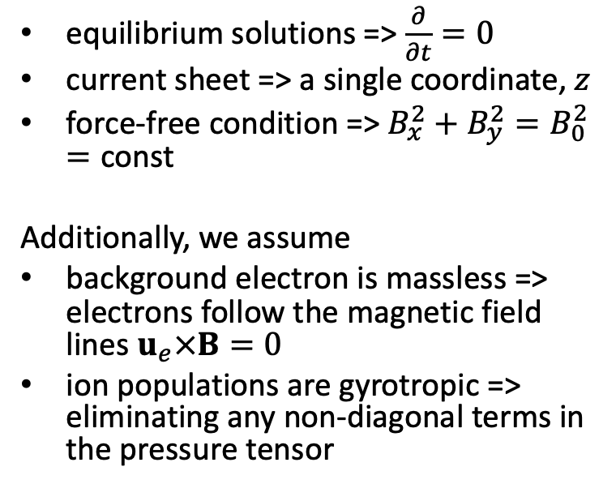
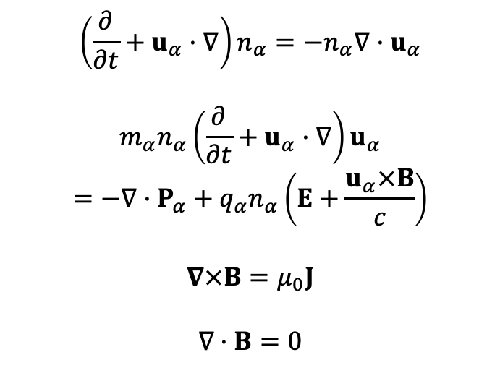
To much, let’s simplify
equilibrium solutions => $\frac{∂}{∂t}=0$
current sheet => a single coordinate, $z$
force-free condition => $B_{x}^{2}+B_{y}^{2}=B_{0}^{2}=\text{const}$
Additionally, we assume
background electron is massless => electrons follow the magnetic field lines $u_{e}×B=0$
ion populations are gyrotropic => eliminating any non-diagonal terms in the pressure tensor
$$\left(\frac{∂}{∂t}+u_{α}·∇\right)n_{α}=−n_{α}∇·u_{α}$$
$$m_{α}n_{α}\left(\frac{∂}{∂t}+u_{α}·∇\right)u_{α}=−∇·P_{α}+q_{α}n_{α}\left(E+\frac{u_{α}×B}{c}\right)$$
$$∇×B=μ_{0}J$$
$$∇·B=0$$
Notes:
magnetic field depends only on a single Cartesian coordinate, $z$

Slide 15
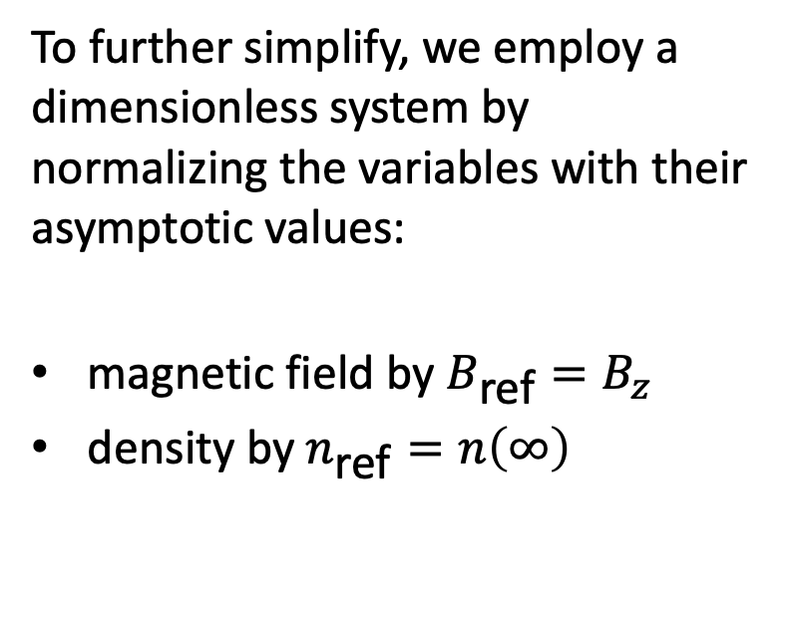
To much, let’s simplify
To further simplify, we employ a dimensionless system by normalizing the variables with their asymptotic values:
magnetic field by $B_{\text{ref}}=B_{z}$
density by $n_{\text{ref}}=n\left(∞\right)$
$$\left(\frac{∂}{∂t}+u_{α}·∇\right)n_{α}=−n_{α}∇·u_{α}$$
$$m_{α}n_{α}\left(\frac{∂}{∂t}+u_{α}·∇\right)u_{α}=−∇·P_{α}+q_{α}n_{α}\left(E+\frac{u_{α}×B}{c}\right)$$
$$∇×B=μ_{0}J$$
$$∇·B=0$$

Slide 16
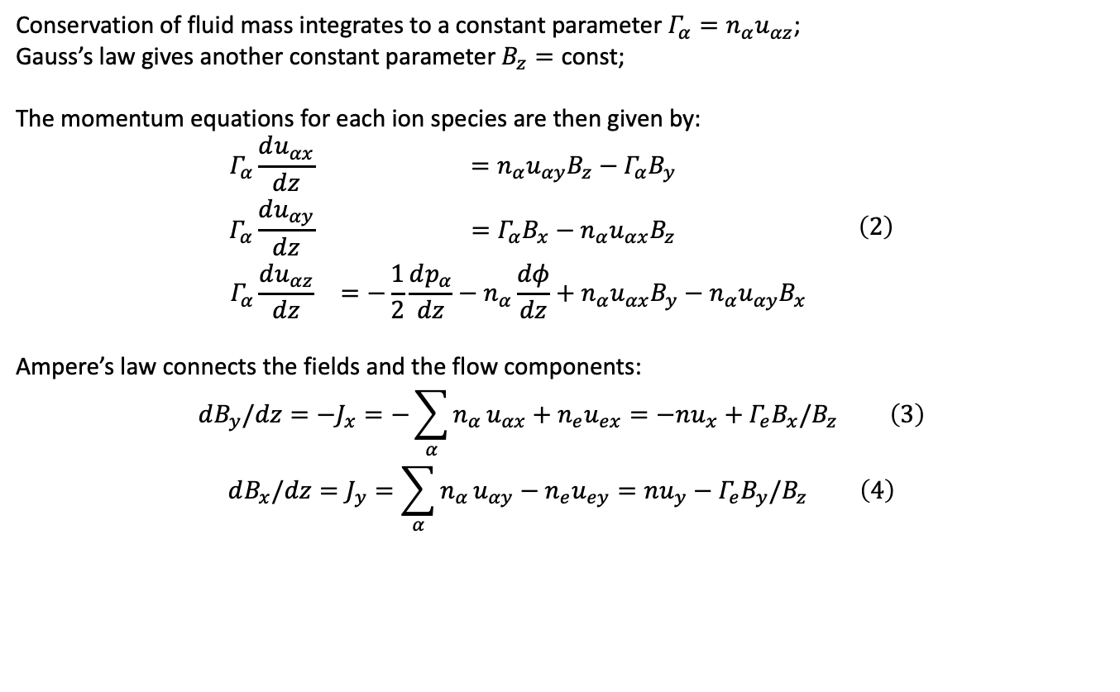
After all the simplifications
Conservation of fluid mass integrates to a constant parameter $Γ_{α}=n_{α}u_{αz}$;
Gauss’s law gives another constant parameter $B_{z}=\text{const}$;
The momentum equations for each ion species are then given by:
$$\begin{matrix}Γ_{α}\frac{du_{αx}}{dz} & =n_{α}u_{αy}B_{z}−Γ_{α}B_{y} \\ Γ_{α}\frac{du_{αy}}{dz} & =Γ_{α}B_{x}−n_{α}u_{αx}B_{z} \\ Γ_{α}\frac{du_{αz}}{dz} & =−\frac{1}{2}\frac{dp_{α}}{dz}−n_{α}\frac{dφ}{dz}+n_{α}u_{αx}B_{y}−n_{α}u_{αy}B_{x}\end{matrix} \left(2\right)$$
Ampere’s law connects the fields and the flow components:
$$dB_{y}/dz=−J_{x}=−\sum_{α}^{​}{n_{α}}u_{αx}+n_{e}u_{ex}=−nu_{x}+Γ_{e}B_{x}/B_{z} \left(3\right)$$
$$dB_{x}/dz=J_{y}=\sum_{α}^{​}{n_{α}}u_{αy}−n_{e}u_{ey}=nu_{y}−Γ_{e}B_{y}/B_{z} \left(4\right)$$

Slide 17
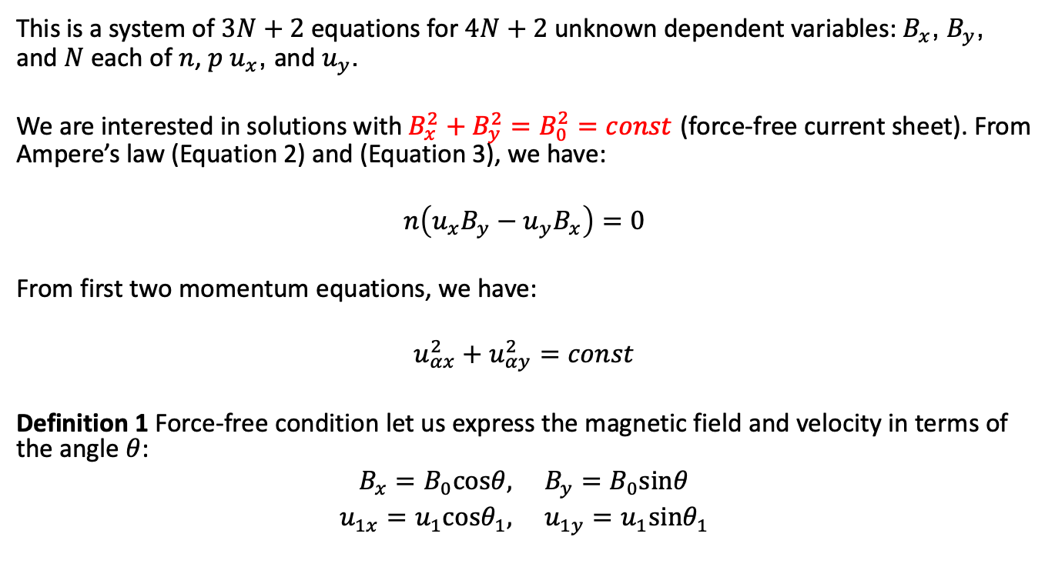
This is a system of $3N+2$ equations for $4N+2$ unknown dependent variables: $B_{x}$, $B_{y}$, and $N$ each of $n$, $p$ $u_{x}$, and $u_{y}$.
We are interested in solutions with $B_{x}^{2}+B_{y}^{2}=B_{0}^{2}=const$ (force-free current sheet). From Ampere’s law (Equation 2) and (Equation 3), we have:
$$n\left(u_{x}B_{y}−u_{y}B_{x}\right)=0$$
From first two momentum equations, we have:
$$u_{αx}^{2}+u_{αy}^{2}=const$$
Definition 1 Force-free condition let us express the magnetic field and velocity in terms of the angle $θ$:
$$B_{x}=B_{0}cosθ, B_{y}=B_{0}sinθ$$
$$u_{1x}=u_{1}cosθ_{1}, u_{1y}=u_{1}sinθ_{1}$$

Slide 18
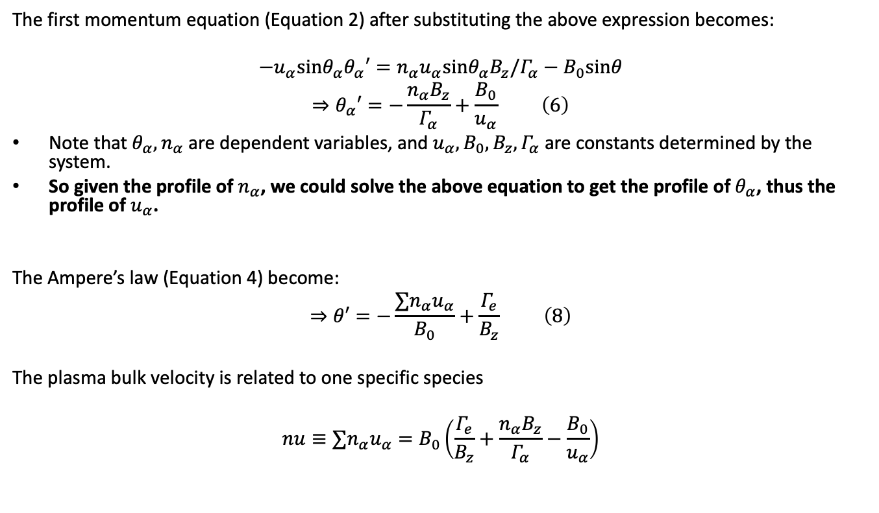
The first momentum equation (Equation 2) after substituting the above expression becomes:
$$−u_{α}sinθ_{α}θ_{α}′=n_{α}u_{α}sinθ_{α}B_{z}/Γ_{α}−B_{0}sinθ$$
$$⇒θ_{α}′=−\frac{n_{α}B_{z}}{Γ_{α}}+\frac{B_{0}}{u_{α}} \left(6\right)$$
Note that $θ_{α},n_{α}$ are dependent variables, and $u_{α},B_{0},B_{z},Γ_{α}$ are constants determined by the system.
So given the profile of $n_{α}$, we could solve the above equation to get the profile of $θ_{α}$, thus the profile of $u_{α}$.
The Ampere’s law (Equation 4) become:
$$⇒θ′=−\frac{∑n_{α}u_{α}}{B_{0}}+\frac{Γ_{e}}{B_{z}} \left(8\right)$$
The plasma bulk velocity is related to one specific species
$$nu≡∑n_{α}u_{α}=B_{0}\left(\frac{Γ_{e}}{B_{z}}+\frac{n_{α}B_{z}}{Γ_{α}}−\frac{B_{0}}{u_{α}}\right)$$
Notes:
The above equation relates the rotation angle $θ$ to the plasma bulk velocity $nu≡∑n_{α}u_{α}$. By equating the above two equations of $θ′$, we could get a equation relating the plasma bulk velocity to one specific species

Slide 19
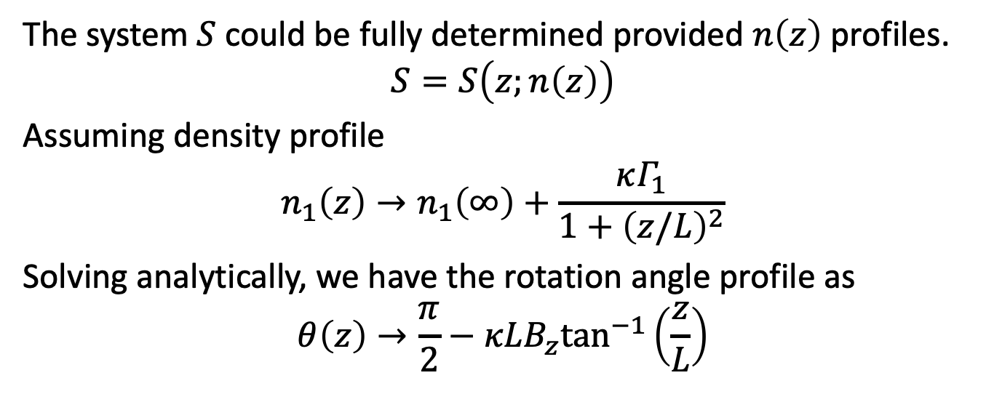
Solutions
The system $S$ could be fully determined provided $n\left(z\right)$ profiles.
$$S=S\left(z;n\left(z\right)\right)$$
Assuming density profile
$$n_{1}\left(z\right)→n_{1}\left(∞\right)+\frac{κΓ_{1}}{1+{\left(z/L\right)}^{2}}$$
Solving analytically, we have the rotation angle profile as
$$θ\left(z\right)→\frac{π}{2}−κLB_{z}\tan^{−1}\left(\frac{z}{L}\right)$$

Slide 20
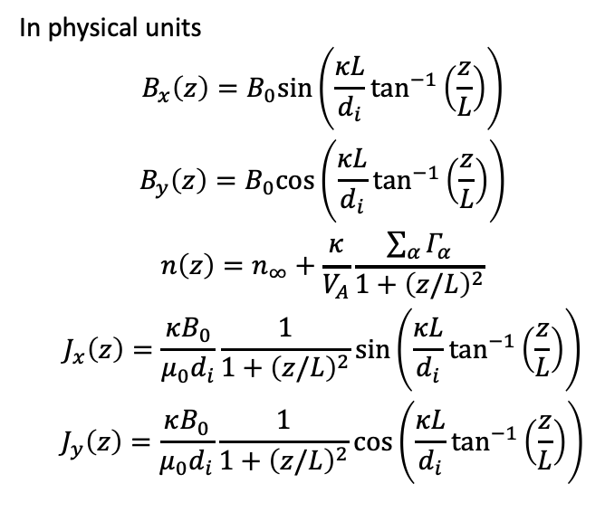
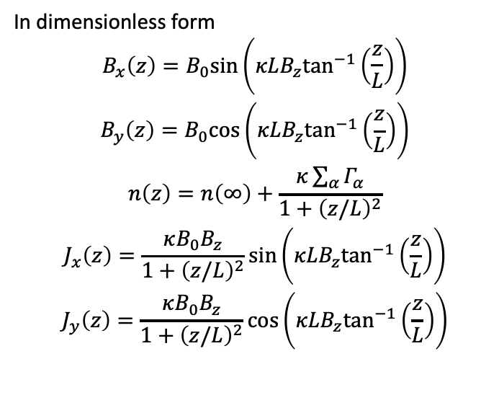
Beutiful moment - solutions
In dimensionless form
$$\begin{matrix} & B_{x}\left(z\right)=B_{0}sin\left(κLB_{z}\tan^{−1}\left(\frac{z}{L}\right)\right) \\ & B_{y}\left(z\right)=B_{0}cos\left(κLB_{z}\tan^{−1}\left(\frac{z}{L}\right)\right) \\ & n\left(z\right)=n\left(∞\right)+\frac{κ\sum_{α}^{​}{Γ_{α}}}{1+{\left(z/L\right)}^{2}} \\ & J_{x}\left(z\right)=\frac{κB_{0}B_{z}}{1+{\left(z/L\right)}^{2}}sin\left(κLB_{z}\tan^{−1}\left(\frac{z}{L}\right)\right) \\ & J_{y}\left(z\right)=\frac{κB_{0}B_{z}}{1+{\left(z/L\right)}^{2}}cos\left(κLB_{z}\tan^{−1}\left(\frac{z}{L}\right)\right)\end{matrix}$$
In physical units
$$\begin{matrix} & B_{x}\left(z\right)=B_{0}sin\left(\frac{κL}{d_{i}}\tan^{−1}\left(\frac{z}{L}\right)\right) \\ & B_{y}\left(z\right)=B_{0}cos\left(\frac{κL}{d_{i}}\tan^{−1}\left(\frac{z}{L}\right)\right) \\ & n\left(z\right)=n_{∞}+\frac{κ}{V_{A}}\frac{\sum_{α}^{​}{Γ_{α}}}{1+{\left(z/L\right)}^{2}} \\ & J_{x}\left(z\right)=\frac{κB_{0}}{μ_{0}d_{i}}\frac{1}{1+{\left(z/L\right)}^{2}}sin\left(\frac{κL}{d_{i}}\tan^{−1}\left(\frac{z}{L}\right)\right) \\ & J_{y}\left(z\right)=\frac{κB_{0}}{μ_{0}d_{i}}\frac{1}{1+{\left(z/L\right)}^{2}}cos\left(\frac{κL}{d_{i}}\tan^{−1}\left(\frac{z}{L}\right)\right)\end{matrix}$$

Slide 21
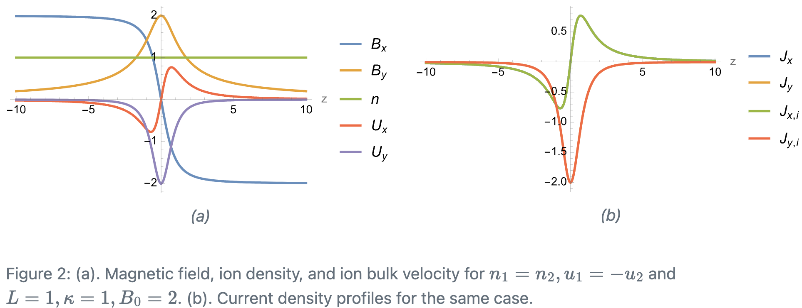
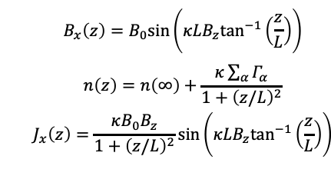
Symmetric case
$$\begin{matrix} & B_{x}\left(z\right)=B_{0}sin\left(κLB_{z}\tan^{−1}\left(\frac{z}{L}\right)\right) \\ & \\ & n\left(z\right)=n\left(∞\right)+\frac{κ\sum_{α}^{​}{Γ_{α}}}{1+{\left(z/L\right)}^{2}} \\ & J_{x}\left(z\right)=\frac{κB_{0}B_{z}}{1+{\left(z/L\right)}^{2}}sin\left(κLB_{z}\tan^{−1}\left(\frac{z}{L}\right)\right) \\ & \end{matrix}$$

Slide 22
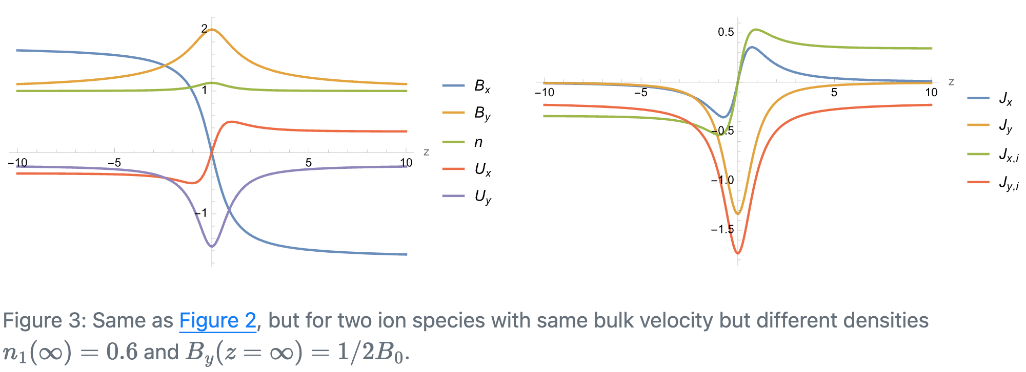
Asymmetric case
$$\begin{matrix} & B_{x}\left(z\right)=B_{0}sin\left(κLB_{z}\tan^{−1}\left(\frac{z}{L}\right)\right) \\ & \\ & n\left(z\right)=n\left(∞\right)+\frac{κ\sum_{α}^{​}{Γ_{α}}}{1+{\left(z/L\right)}^{2}} \\ & J_{x}\left(z\right)=\frac{κB_{0}B_{z}}{1+{\left(z/L\right)}^{2}}sin\left(κLB_{z}\tan^{−1}\left(\frac{z}{L}\right)\right) \\ & \end{matrix}$$

Slide 23
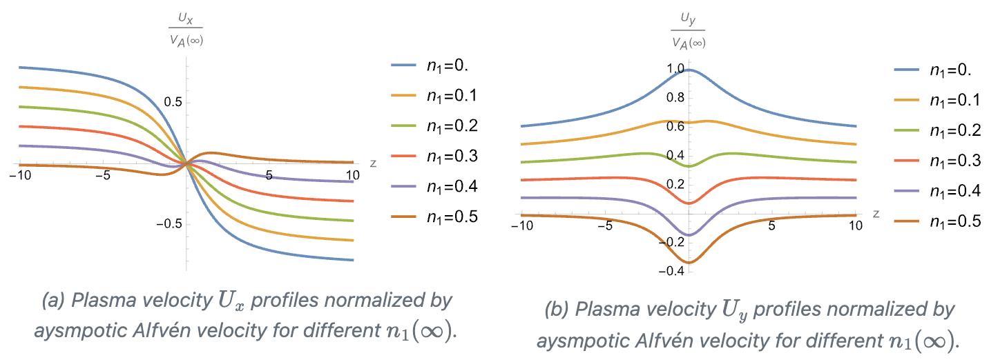
Velocity profile - effect of multiple fluids

Slide 24
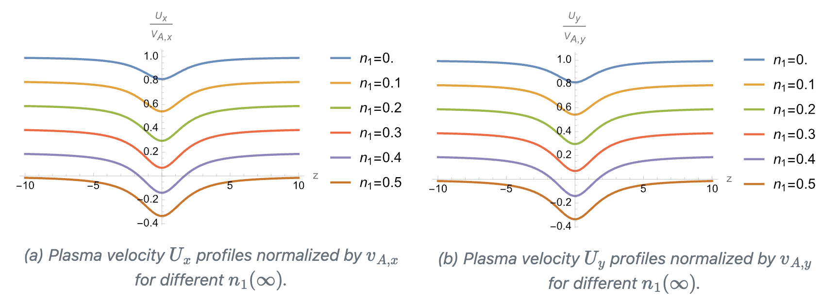
Alfvénicity

Slide 25
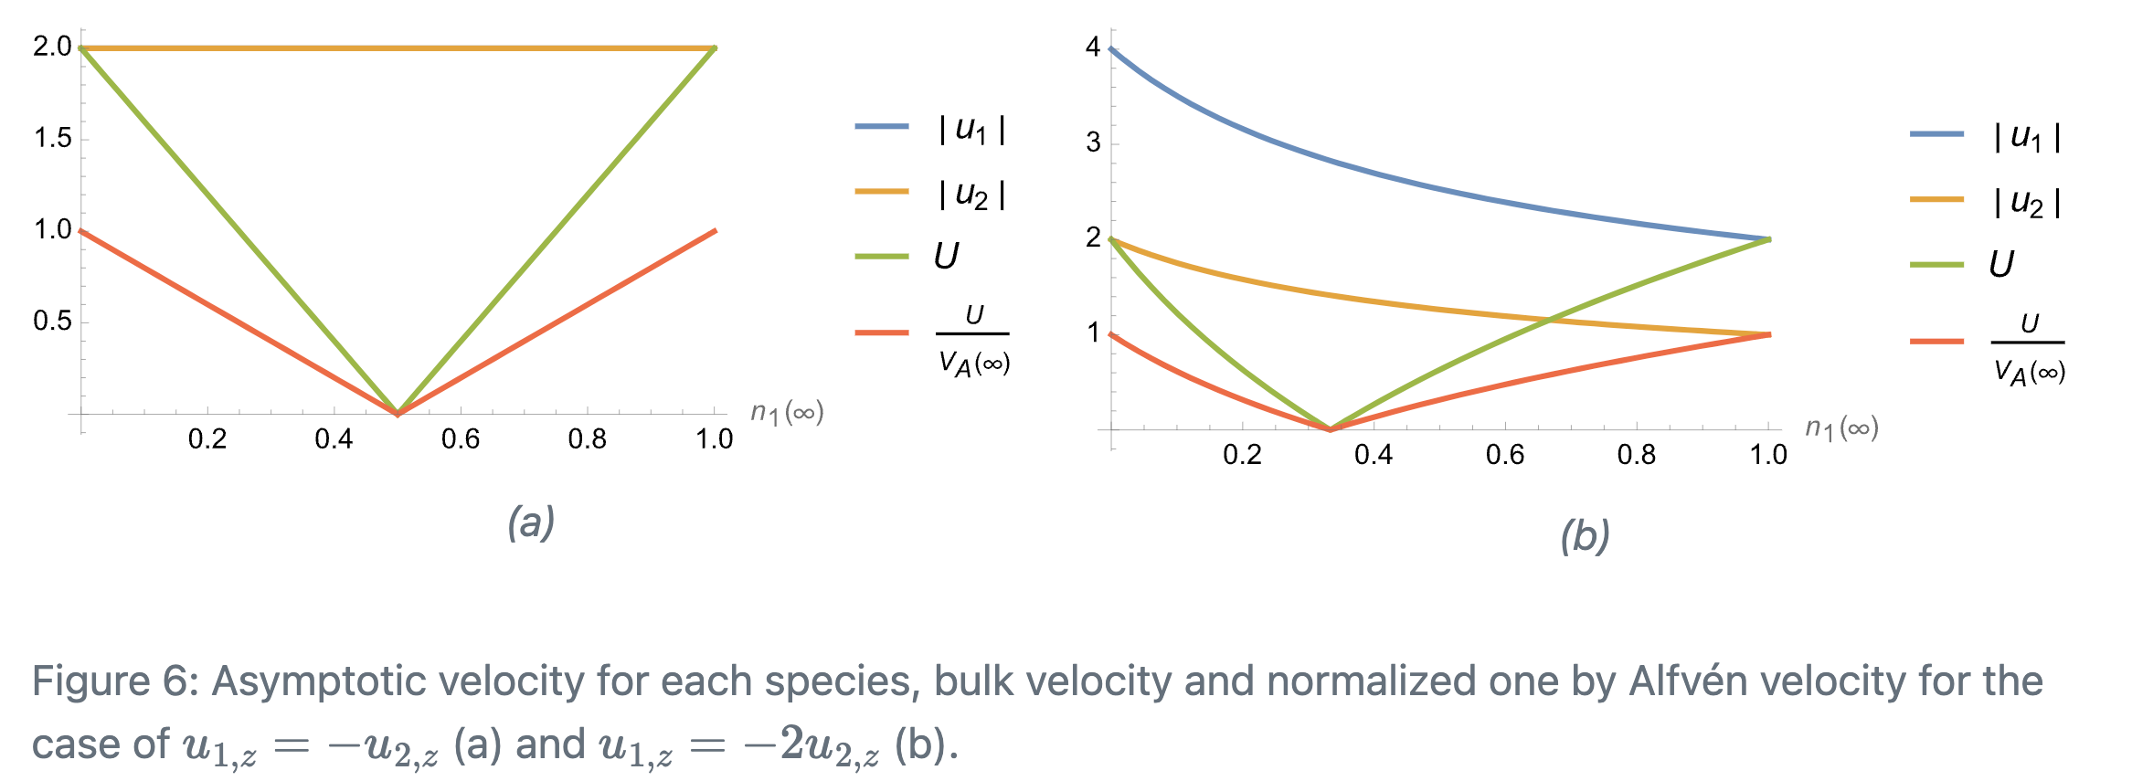
Asymptotic velocity

Slide 26
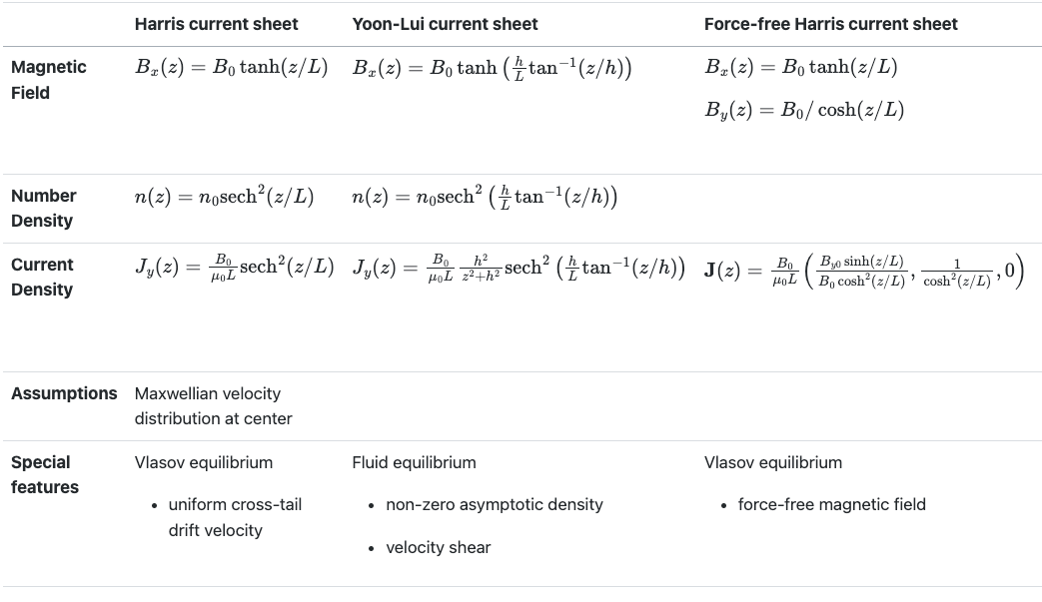
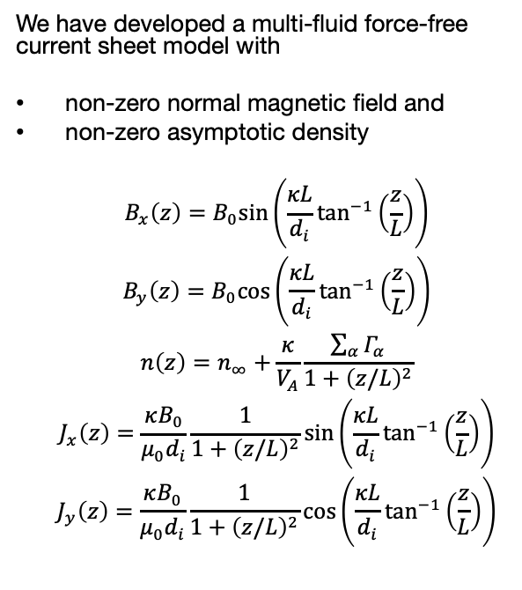
Conclusion
We have developed a multi-fluid force-free current sheet model with
non-zero normal magnetic field and
non-zero asymptotic density
$$\begin{matrix} & B_{x}\left(z\right)=B_{0}sin\left(\frac{κL}{d_{i}}\tan^{−1}\left(\frac{z}{L}\right)\right) \\ & B_{y}\left(z\right)=B_{0}cos\left(\frac{κL}{d_{i}}\tan^{−1}\left(\frac{z}{L}\right)\right) \\ & n\left(z\right)=n_{∞}+\frac{κ}{V_{A}}\frac{\sum_{α}^{​}{Γ_{α}}}{1+{\left(z/L\right)}^{2}} \\ & J_{x}\left(z\right)=\frac{κB_{0}}{μ_{0}d_{i}}\frac{1}{1+{\left(z/L\right)}^{2}}sin\left(\frac{κL}{d_{i}}\tan^{−1}\left(\frac{z}{L}\right)\right) \\ & J_{y}\left(z\right)=\frac{κB_{0}}{μ_{0}d_{i}}\frac{1}{1+{\left(z/L\right)}^{2}}cos\left(\frac{κL}{d_{i}}\tan^{−1}\left(\frac{z}{L}\right)\right)\end{matrix}$$

Slide 27
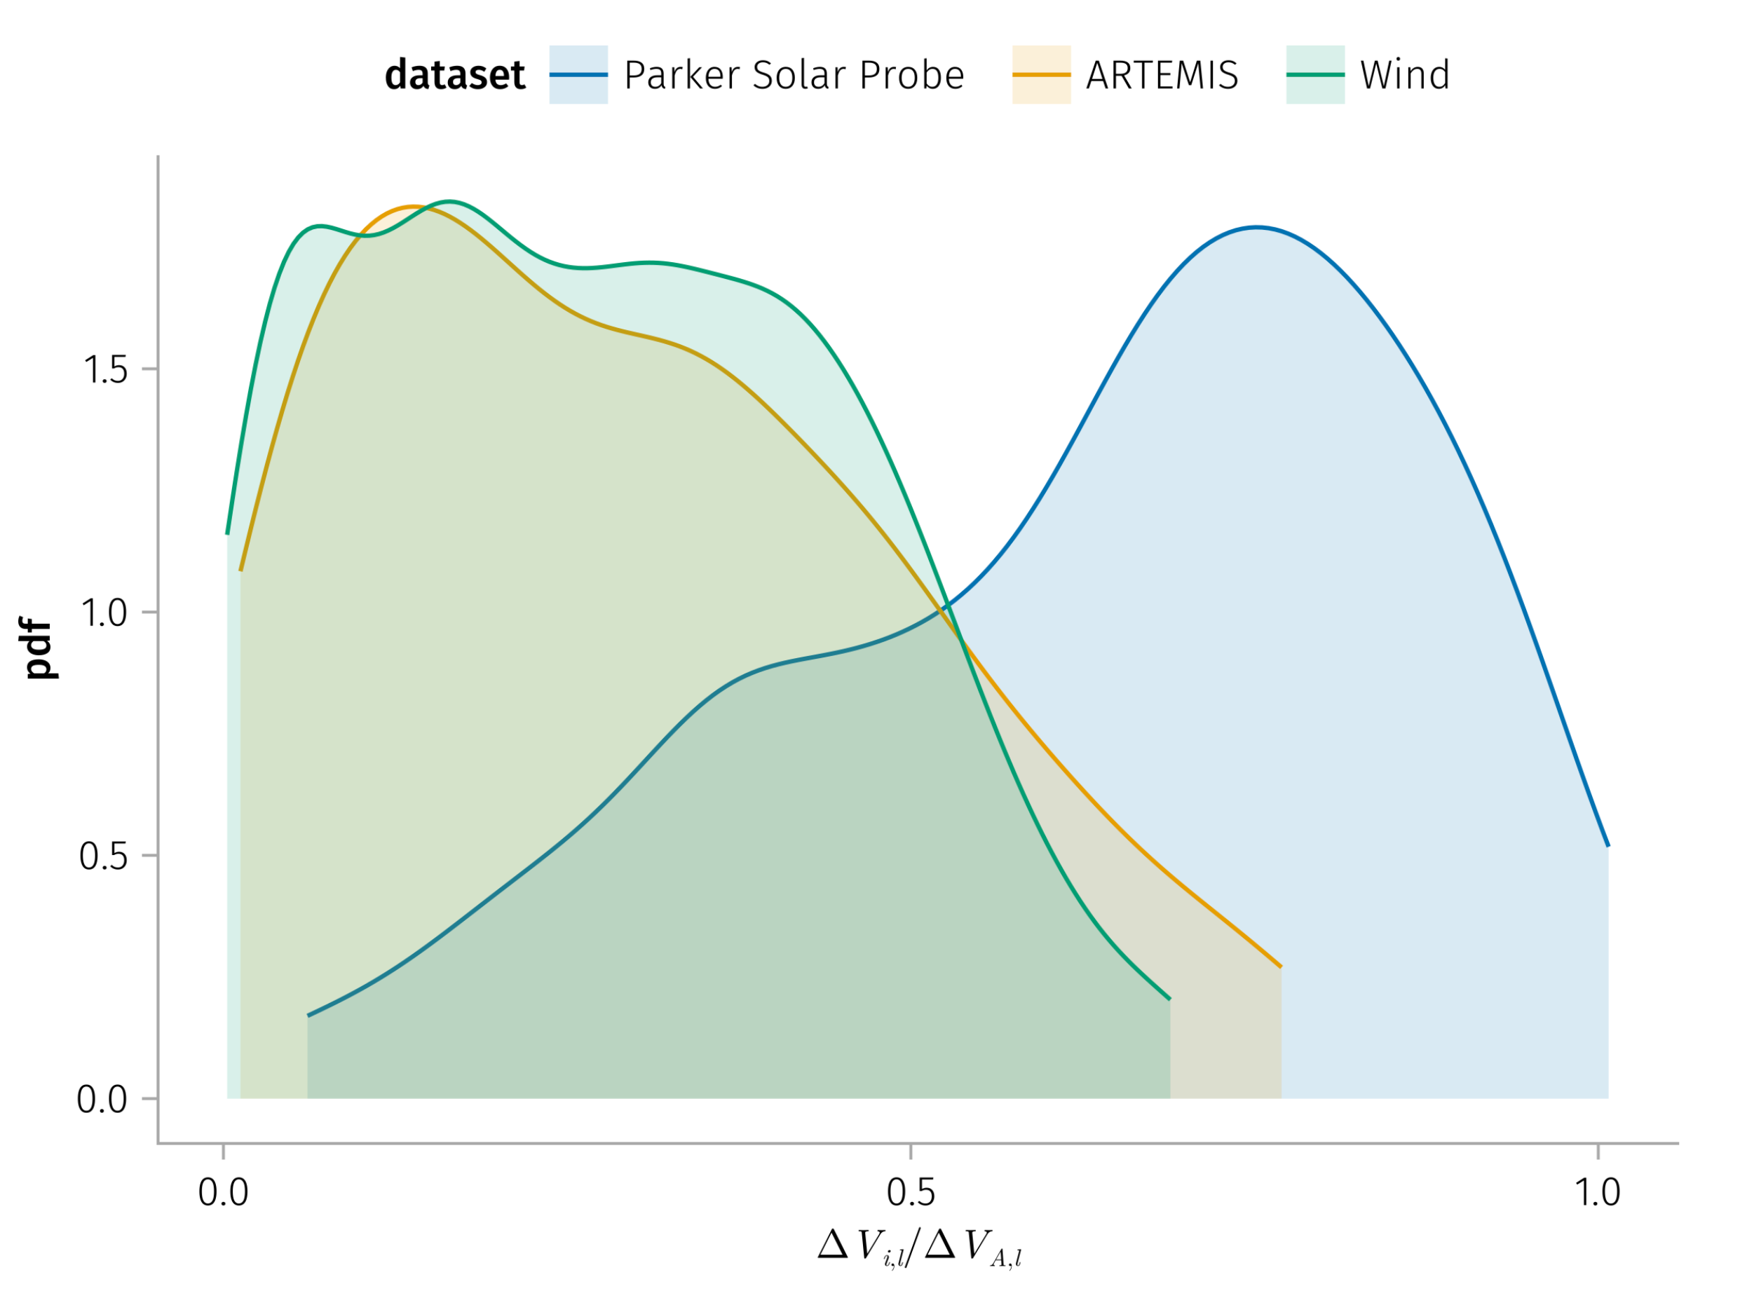

Slide 28
References

Slide 29
Steinhauer, McCarthy, and Whipple (2008)
Steinhauer, L. C., M. P. McCarthy, and E. C. Whipple. 2008. “Multifluid Model of a One-Dimensional Steady State Magnetotail Current Sheet.” Journal of Geophysical Research: Space Physics 113 (A4). https://doi.org/10.1029/2007JA012578.

